Slide 1
2020 NYC Shootings By Borough
DTSA 5301
June 3rd, 2021

Slide 2
Contents of Dataset
Number of shootings between 2006 and 2020
Date and time of the shooting
Perpetrator’s and victim’s race and sex
Latitude and longitude coordinates
Borough where the shooting occurred

Slide 3
Tools Used
Utilized R studio/R Markdown to tidy and analyze the dataset
Research Focus
Studied number of shootings by borough in 2020

Slide 4
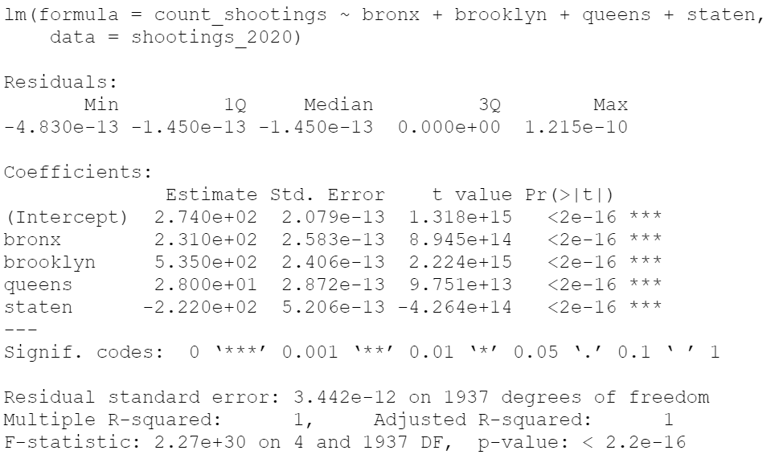
Linear Regression Model
$${count_shootings}_{i}=α_{i}+β_{1i}{Bronx}_{i}+β_{2i}{Brooklyn}_{i}+β_{3i}{Queens}_{i}+β_{4i}{Staten}_{i}+ε_{i}$$
**Note: omitted Manhatten to avoid redundancy

Slide 5
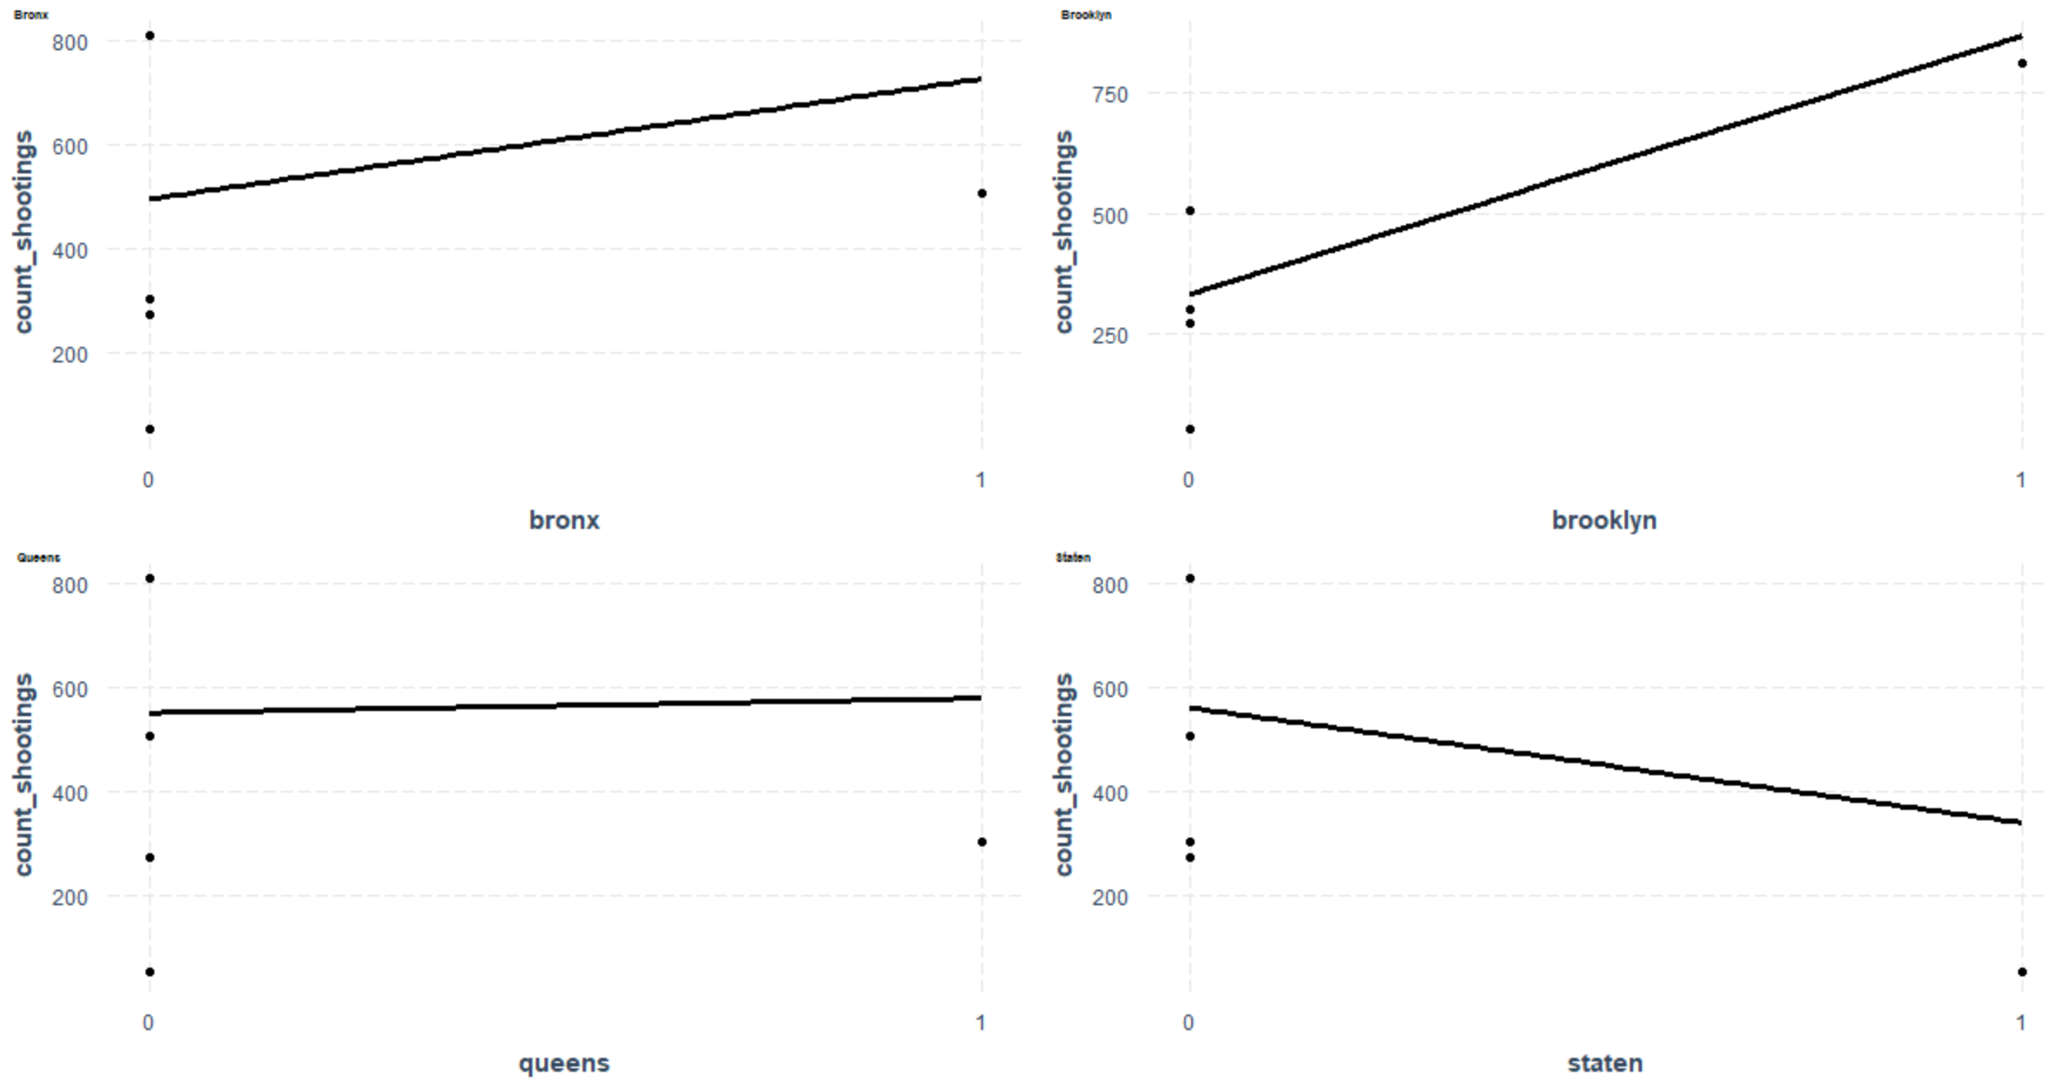
Effects Plots

Slide 6
Identify Bias
Lower-income neighborhoods typically have higher crime rate
Bronx has lowest median household income (Chen, 2018)
Expected to see Bronx have the highest number of shootings
BUT…

Slide 7
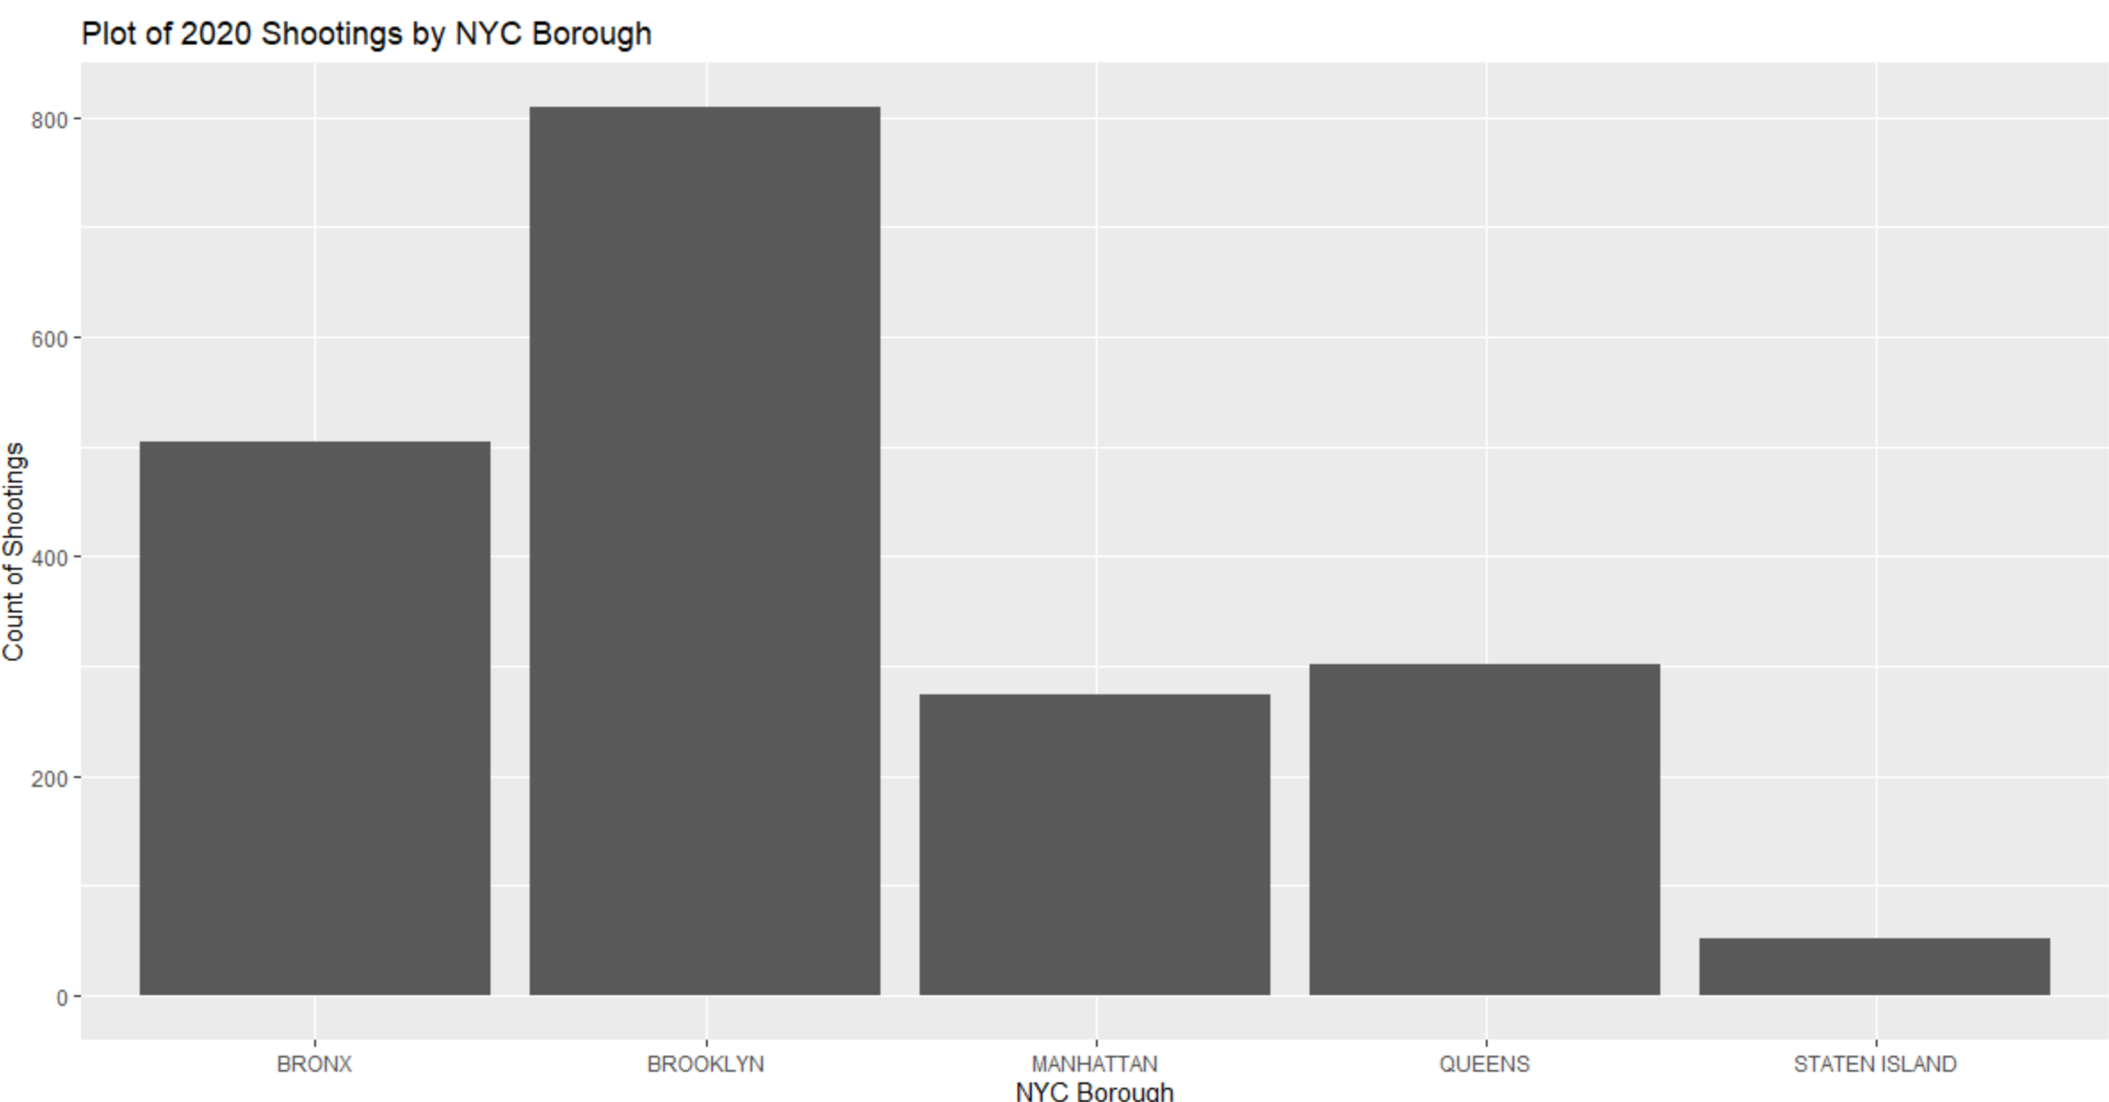
Brooklyn has the highest number of 2020 shootings

Slide 8
Limitations
R output contained warning of “perfect fit”
Only indicator variables were used
Mostly categorical variables in dataset
Expertise with R
Experience with linear regression/data modeling

Slide 9
Conclusion
Brooklyn = highest number of shootings
Staten Island = lowest number of shootings
Open for revision and future research
Hope to develop more skills to gain deeper insights

Slide 10
Citations
1. NYC JSON, Data.Gov/data.cityofnewyork.us (2020). *NYPD Shooting Incident Data (Historic)*. Retrieved from https://catalog.data.gov/dataset/nypd-shooting-incident-data-historic
2. Chen, S. (2018, September 14). The Bronx Is Great, Thonx. The New York Times. https://www.nytimes.com/2018/09/14/realestate/the-bronx-is-great-thonx.html
3. This report and the supporting code can be found at this location on GitHub: https://github.com/cuboulderja/DTSA5301/tree/main

